Slide 1

Compensation paid to residents
How we put things right when our service falls short — 2027/28, year to date (April to August)
Peaks & Plains Housing Trust · Compensation report · April–August 2027

Slide 2
What compensation is, and why we pay it
Compensation is money we pay to residents when our service doesn't meet the standard you should be able to expect — not a bonus, and not a goodwill gesture.
Compensation is typically paid for things like:
• A missed or repeatedly rescheduled repair appointment
When we accept that we got something wrong, putting it right sometimes means a payment as well as fixing the underlying problem. This report is about being open about when, where, and how much.
• A repair that took far longer than it should have
• Distress or inconvenience caused by a service failure
• Reasonable costs a resident was caused to cover themselves
2

Slide 3
THE HEADLINE
£29,316
paid directly to residents across 89 individual payments, April to August 2027
Every one of those payments reflects a time our service didn't meet the standard you should expect. The rest of this report shows where the money went, and what's behind the busiest month.
3

Slide 4
Where the money went
Every service area with a compensation payment, April to August 2027
Service area | Payments | Amount
Repairs & Voids – Planning | 55 | £16,237.04
Maintenance Investment | 14 | £7,520.98
New Tenancies | 6 | £2,125.00
Asset & Property Control | 5 | £1,788.48
Customer Voice | 3 | £920.00
Windows & Doors | 1 | £400.00
Customer Services | 5 | £325.00
Total | 89 | £29,316.50
4

Slide 5
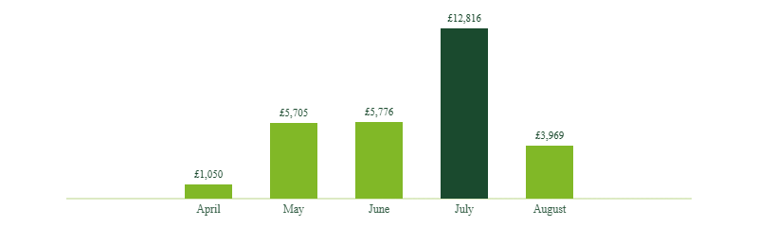
The month-by-month picture
July was the busiest month for compensation. The next slide explains what was behind it.
5

Slide 6
What's behind July's total
July's total is a volume story, not one big incident: more residents affected by delays, most for a modest amount each.
Paid in July
Of which, Repairs & Voids – Planning
£12,815.80
£10,695.80
40 payments · average £320 per payment
28 payments · average £382 per payment
What we're doing: [additional planning capacity / process change to reduce repair delays — expected impact by [date]].
6

Slide 7
How to raise something, or find out more
This is part of our STAIRs commitment to being open about how we're performing, including when we get things wrong.
Make a complaint or claim
See the full breakdown
Give feedback on this report
[phone / email / complaints form link]
[link to full compensation dataset / STAIRs page]
[resident panel / survey link]
7

